Slide 1

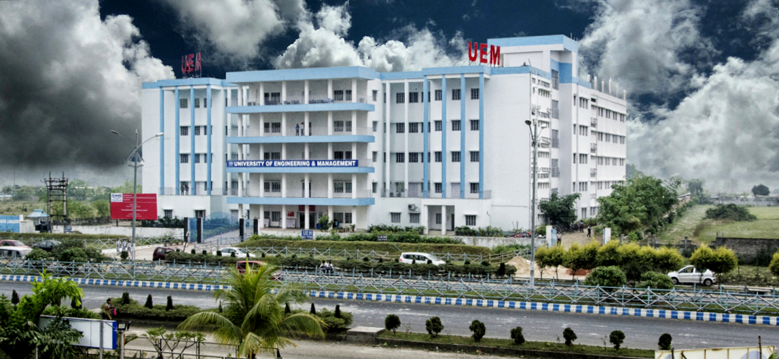
UNIVERSITY OF ENGINEERING & MANAGEMENT, KOLKATA
Course Name : Database Management System
Dr. Sandip Mandal
Dept. of CSE, UEM Kolkata
WhatsApp : +91-8449007365
Email : sandip.mandal@uem.edu.in

Slide 2
Module 2: Generalization and Aggregation
 | UNIVERSITY OF ENGINEERING & MANAGEMENT, KOLKATA

Slide 3
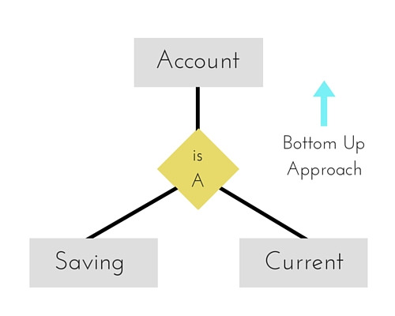
Generalization
 | UNIVERSITY OF ENGINEERING & MANAGEMENT, KOLKATA
A bottom-up design process – combine a number of entity sets that share the same features into a higher-level entity set.
Specialization and generalization are simple inversions of each other; they are represented in an E-R diagram in the same way.
The terms specialization and generalization are used interchangeably.

Slide 4
Design Constraints on a Specialization/Generalization
 | UNIVERSITY OF ENGINEERING & MANAGEMENT, KOLKATA
Completeness constraint -- specifies whether or not an entity in the higher-level entity set must belong to at least one of the lower-level entity sets within a generalization.
total: an entity must belong to one of the lower-level entity sets
partial: an entity need not belong to one of the lower-level entity sets
Partial generalization is the default. We can specify total generalization in an ER diagram by adding the keyword total in the diagram and drawing a dashed line from the keyword to the corresponding hollow arrow-head to which it applies (for a total generalization), or to the set of hollow arrow-heads to which it applies (for an overlapping generalization).
The student generalization is total: All student entities must be either graduate or undergraduate. Because the higher-level entity set arrived at through generalization is generally composed of only those entities in the lower-level entity sets, the completeness constraint for a generalized higher-level entity set is usually total

Slide 5
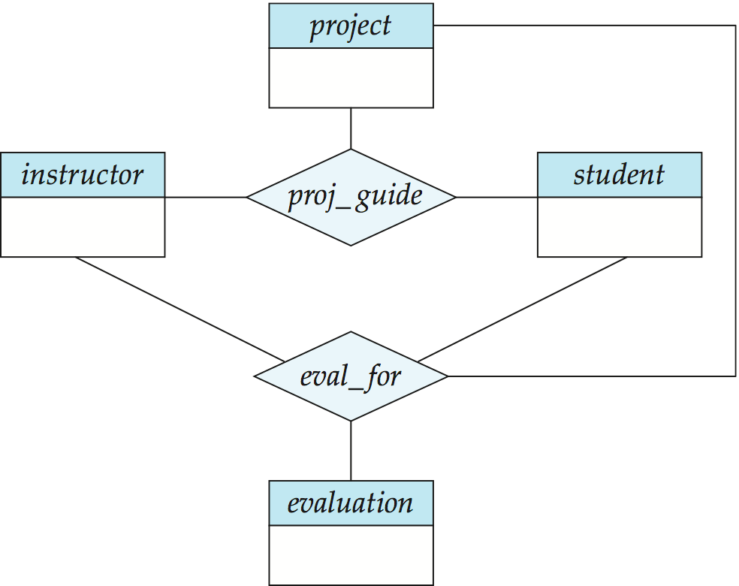
Aggregation
 | UNIVERSITY OF ENGINEERING & MANAGEMENT, KOLKATA
Consider the ternary relationship proj_guide, which we saw earlier
Suppose we want to record evaluations of a student by a guide on a project

Slide 6
Aggregation (Cont.)
 | UNIVERSITY OF ENGINEERING & MANAGEMENT, KOLKATA
Relationship sets eval_for and proj_guide represent overlapping information
Every eval_for relationship corresponds to a proj_guide relationship
However, some proj_guide relationships may not correspond to any eval_for relationships
So we can’t discard the proj_guide relationship
Eliminate this redundancy via aggregation
Treat relationship as an abstract entity
Allows relationships between relationships
Abstraction of relationship into new entity

Slide 7
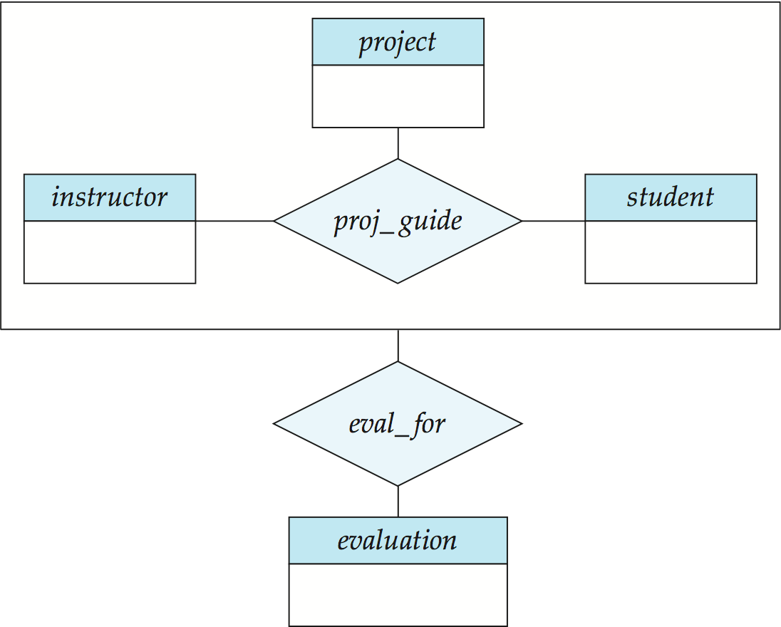
Aggregation (Cont.)
 | UNIVERSITY OF ENGINEERING & MANAGEMENT, KOLKATA
Eliminate this redundancy via aggregation without introducing redundancy, the following diagram represents:
A student is guided by a particular instructor on a particular project
A student, instructor, project combination may have an associated evaluation
Notes:
7

Slide 8
Representing Aggregation via Schemas
 | UNIVERSITY OF ENGINEERING & MANAGEMENT, KOLKATA
To represent aggregation, create a schema containing
Primary key of the aggregated relationship,
The primary key of the associated entity set
Any descriptive attributes
In our example:
The schema eval_for is:
eval_for (s_ID, project_id, i_ID, evaluation_id)
The schema proj_guide is redundant.

Slide 9
Mock Exercise
 | UNIVERSITY OF ENGINEERING & MANAGEMENT, KOLKATA
Consider a university database for the scheduling of classrooms for final exams.
This database could be modeled as the single entity set exam, with attributes course-name, section-number, room-number, and time. Alternatively, one or more additional entity sets could be defined, along with relationship sets to replace some of the attributes of the exam entity set,
as
• course with attributes name, department, and c-number
• section with attributes s-number and enrollment, and dependent as a weak entity set on course
• room with attributes r-number, capacity, and building a.
Show an E-R diagram illustrating the use of all three additional entity sets listed.

Slide 10
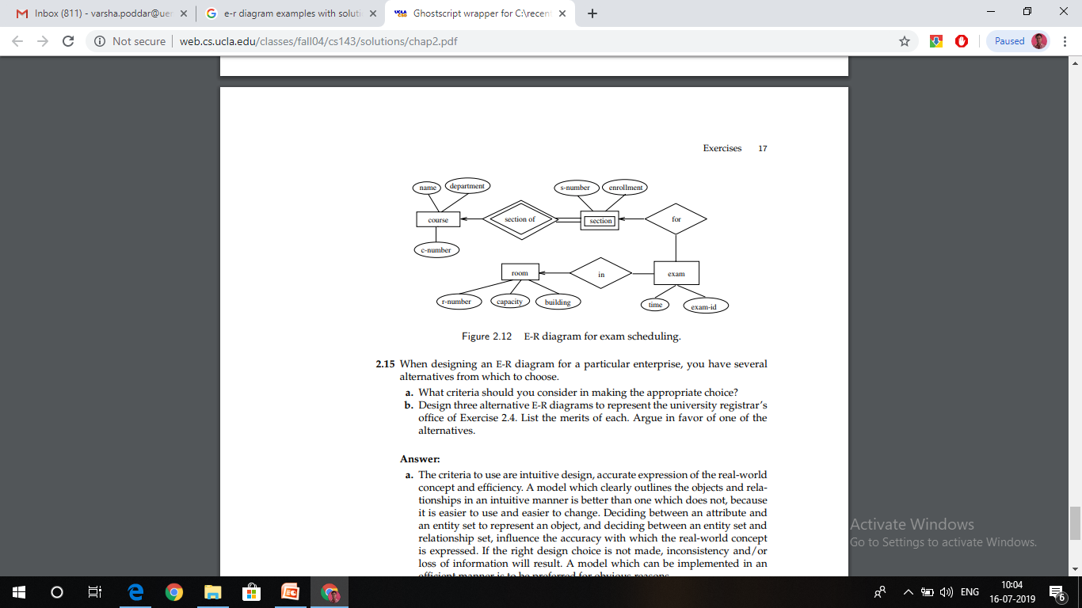
 | UNIVERSITY OF ENGINEERING & MANAGEMENT, KOLKATA

Slide 11

 | UNIVERSITY OF ENGINEERING & MANAGEMENT, KOLKATA
Thank You

